Slide 1
Machine Learning Project: Laptop Price Estimation
By Rana Dbouk, Mohamad Khalifeh, and Omar Al Itani

Slide 2
Introduction
Ever felt confused when buying a laptop?
How is the price of a laptop affected by its specs?
How can we, as computer science students, help people with no technical background when looking for a laptop?

Slide 3
Preprocessing Methods
Data Observation
Train Test Split
One Hot Encoding
1
2
3
4
5
6
Data Cleaning
Feature Scaling
K-Fold Cross Validation

Slide 4
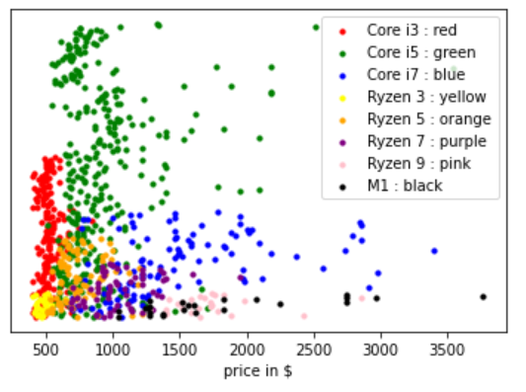
Trends in Data
Figure1 : Discovering Linear Relationship between Number of Cores and Price

Slide 5
Modeling Methods
Linear Regression
Parametric regression algorithm that assumes a linear relationship between multiple independent variables and the output.
K-NN
Training is memorizing the data so that it can find the average values of the k-neighbors during prediction of a new point.
SVR
Finds the best fit line is the hyperplane that has the maximum number of points, within a threshold value. The threshold value is the distance between the hyperplane and boundary line.
Random Forest
Random Forest grows multiple decision trees that are merged. It uses bagging and feature randomness when building each tree to find uncorrelated forest of trees whose prediction by committee is more accurate than that of any individual tree.

Slide 6
Results: Regression Scores
 | Linear Regression | KNN (K=4) | Random Forests | SVR (linear kernel)
MSE | 101124 | 79524 | 57259 | 85729
RMSE | 318 | 282 | 239 | 293
R-Squared | 0.73 | 0.74 | 0.81 | 0.66

Slide 7
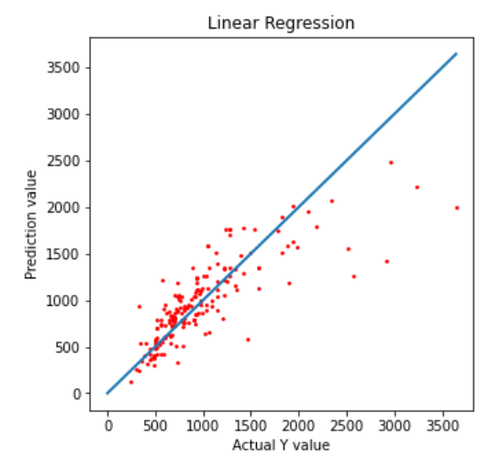
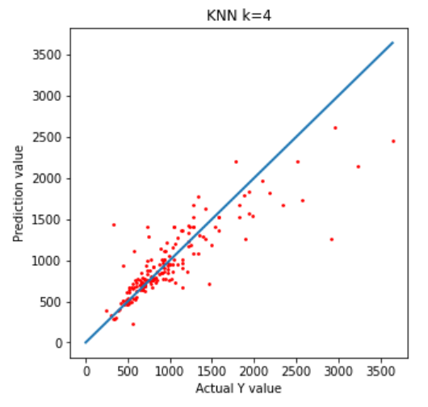
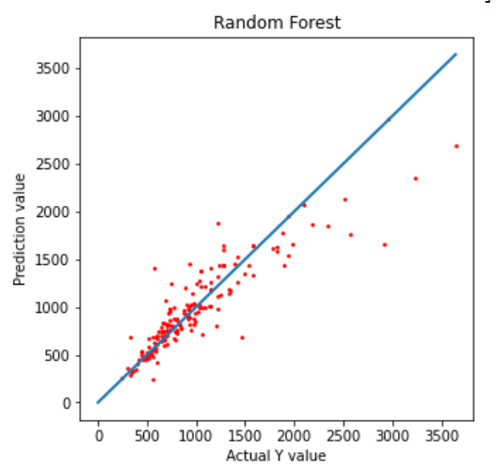
Model Visualizations

Slide 8
Discussion
Linear Regression CV Results
R2 score varies with 10-Fold cross validation, ranging between 0.607 and 0.76
K-NN CV Results
Optimal K changes to be K=5, with R2 score decreasing to 0.67.
Limited Dataset
The difference in R2 value when applying cross validation is expected, due to limited instances on laptops that has some special and rarer specs.
Linear Relationship
Based on our previous visualizations on the relationship between the features and the output, a linear relationship was suspected, and the results show some linearity.
SVR
Has the highest RMSE and lowest R2 scores. Best performing kernel was the linear kernel. This is logical because of the linear relationships between some features and the output.
Random Forest
Has the lowest RMSE and highest R2-scores, in train-test split and cross validation. The way in which we fairly price a laptop is very similar to how a decision tree works. This explains the high performance of this model.

Slide 9
Conclusion
Multiple regression models were implemented to understand the relationship between several laptop specs and the predicted price.
Random Forest best fitted our data.
Our models couldn't reach high performances due to scarce data on some types of laptops.

Slide 10
Contributions
Work across all phases was evenly distributed.
Omar: Data cleaning & transformation, Random Forest model fitting.
Mohamad: Feature selection, Data Visualization, SVR model fitting.
Rana: Data Visualization, LR and KNN model fitting.
Everyone contributed in the Discussion & Results section.

Slide 11
Thanks!
Any questions ?

